Slide 1
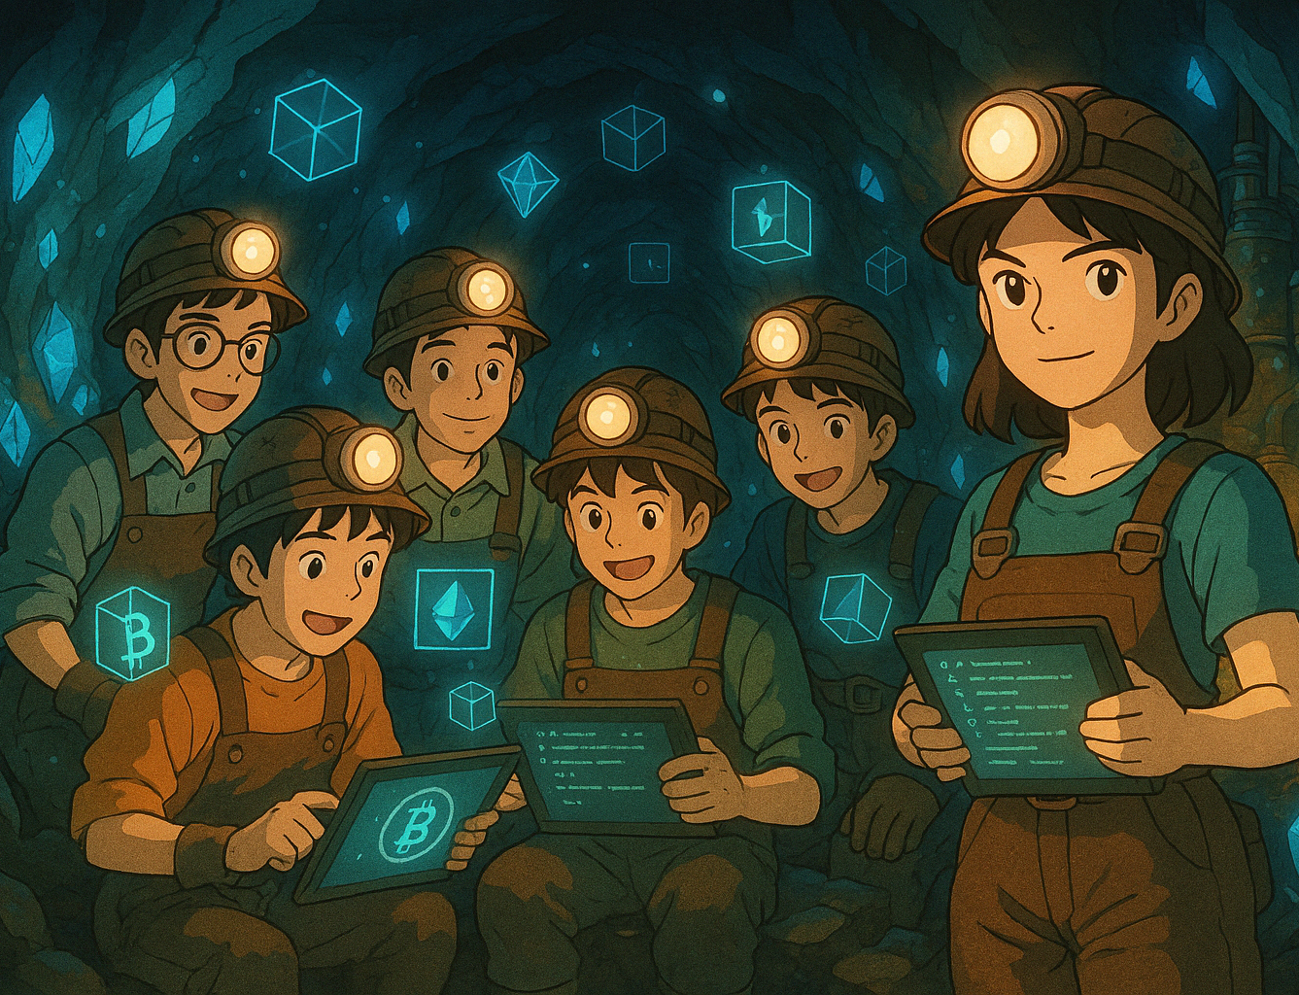
CodeMiners Presents Crypto Miners – A Decentralized NFT Marketplace on Internet Computer
Built using Motoko by following miners:
Nishant Acharekar (801363902)
Mihir Phatak (801358341)
Shubham Kakade (801413848)
Calvin Pinto (801320115)
Deepiga Sengottuvelu Ravichandran (801370629)
Sandesh Mahajan (801366489)

Slide 2
Introduction to Motoko
Motoko is a statically typed language developed by the DFINITY Foundation.
Designed specifically for smart contract development on the Internet Computer.
Offers memory safety, actor-based concurrency, and seamless integration with WebAssembly.
Simplifies building scalable, decentralized web applications.

Slide 3
Timeline of Motoko Development
2019
Motoko released by DFINITY
2020
Smart contract adoption begins
2022
Async support and rich standard libraries
2023–2025
Used in dApps, NFT platforms, DAOs, and finance apps

Slide 4
Why We Chose Motoko
Decentralized Logic: Enables secure, actor-based smart contracts for trustless operations
Type Safety: Reduces runtime bugs with strong compile-time checks
WebAssembly-Ready: Executes efficiently across modern platforms
Seamless ICP Integration: No need for third-party cloud storage—everything runs natively on-chain
Built for Developers: Designed with simplicity, scalability, and high performance in mind
Supports Actor Model: Perfect fit for modular, asynchronous, and decentralized dApp development

Slide 5
Key Features of Motoko & Real-World Applications
Key Features of Motoko:
Strong typing and compile-time safety
Lightweight, efficient code execution via WebAssembly
Actor-based model for modular, secure dApps
Built-in support for canister (smart contract) deployment
Real-World Applications:
NFT marketplaces (e.g., Entrepot)
Decentralized finance (DeFi) apps
Web3 social platforms
DAO infrastructure
Internet identity and authentication systems

Slide 6

Introduction to Our Project
Project Title: Decentralized NFT Marketplace on Internet Computer Goal: Build a secure, peer-to-peer platform where users can mint, buy, and sell NFTs without intermediaries.
Built With:
Frontend: React.js + Bootstrap
Smart Contracts: Motoko
Blockchain: Internet Computer (ICP)
Storage: ICP Canisters for NFT metadata and transaction history

Slide 7
Core Features of Our Marketplace
NFT Minting: Upload and convert assets into NFTs
List for Sale: Set prices and put NFTs up for sale
Buy NFTs: Purchase listed NFTs using ICP tokens
Ownership Transfer: Handled securely by smart contracts
My NFTs: Track and manage owned assets
NFT Discovery: Dynamic gallery of trending NFTs

Slide 8
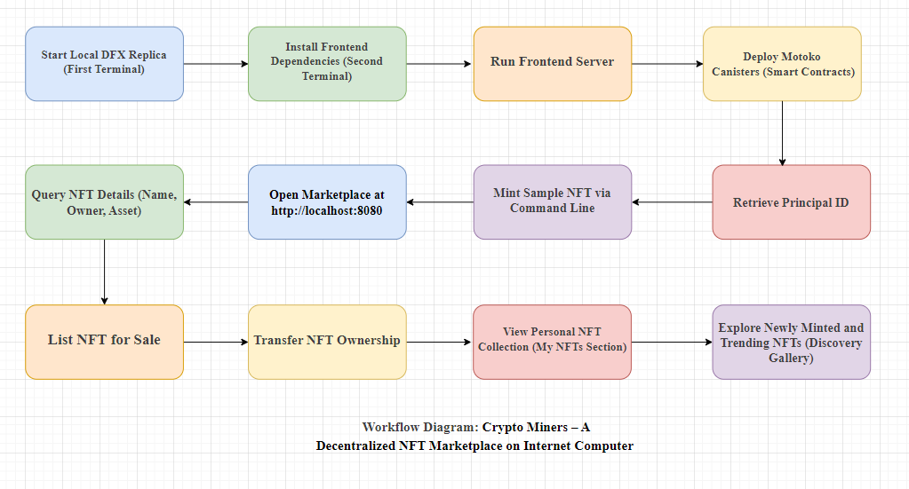
Workflow: 12 steps to run this project.

Slide 9
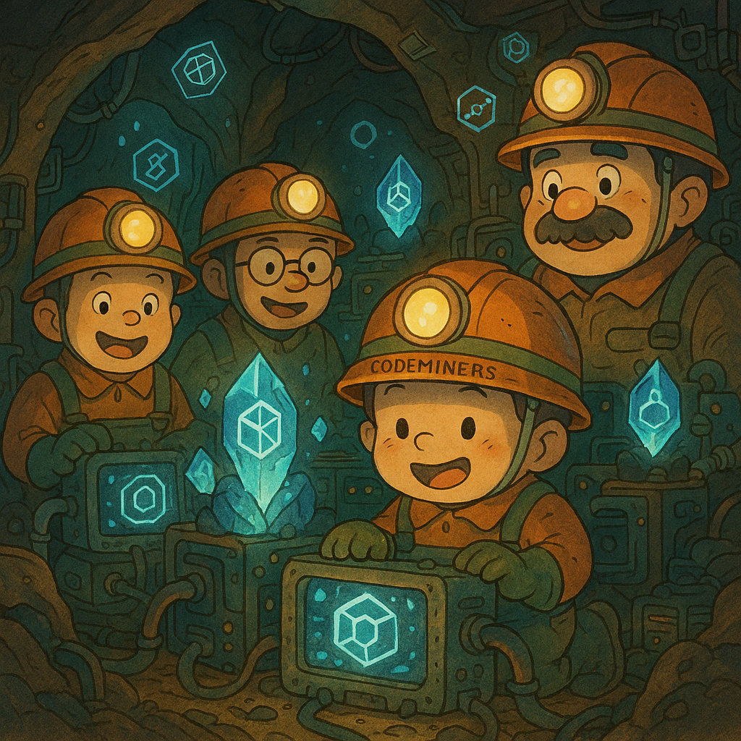
Thank You
Built with passion by CodeMiners
Powered by Motoko and the Internet Computer

